Slide 1
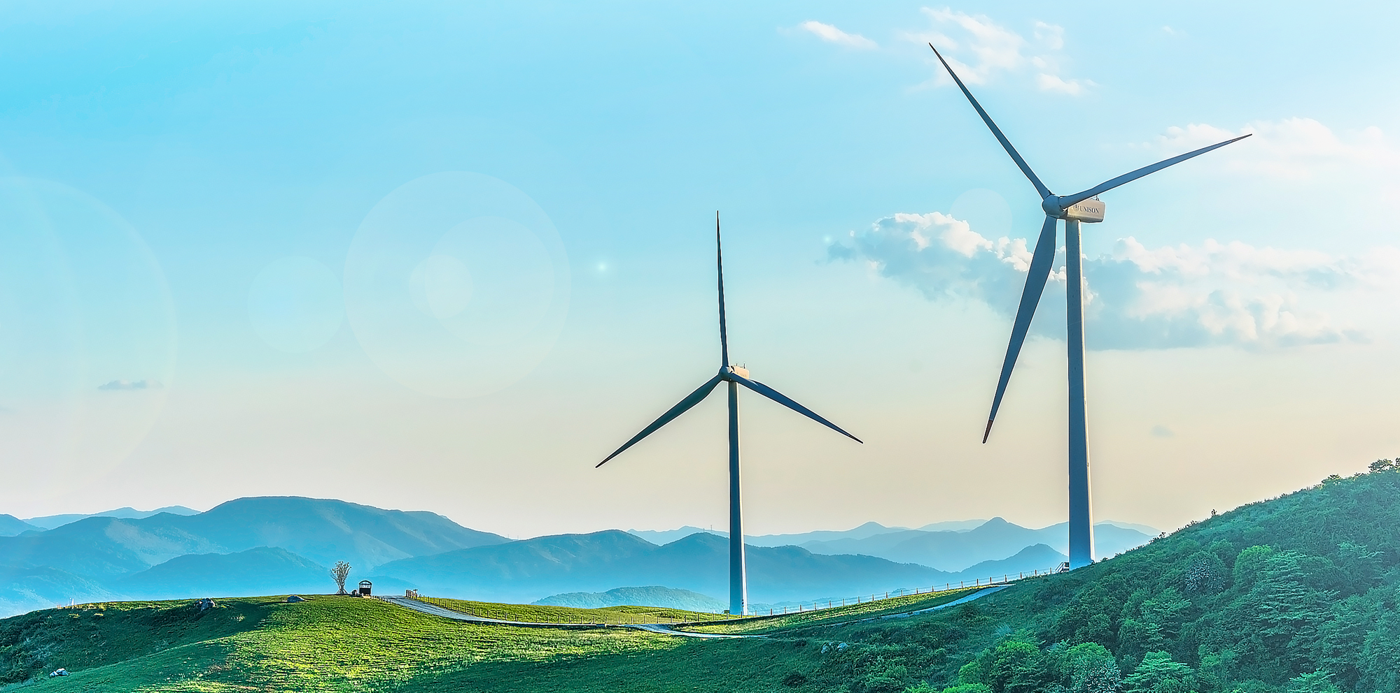





Developing Ambition Levels 1-4
and Electricity Sector
Onesmus Mwabonje
Paisan Sukpanit
Victoria Hoare
Jeremy Woods
2050 Calculator

Slide 2
Agenda
The principles of Levels 1, 2, 3 and 4
Level 4
Level 1
Levels 2 and 3
Trajectories between now and 2050
Explaining this to your stakeholders
Deep dive into the Electricity - sector logic tree

Slide 3
These are broad guidelines for what levels 1, 2, 3 and 4 should be based on. Judgement is important.
Level 1
Level 2
Level 3
Level 4
No mitigation effort (business as usual)
Effort described by most stakeholders as achievable
Effort needing significant change – hard but deliverable
The maximum possible due to physical / practical constraints only
(similar to ‘technical potential’)
These are broad guidelines for developing the trajectories in each sector. Clearly, there is an element of judgement, particularly when comparing very different sectors. The aim is to achieve broadly comparable levels of effort in each trajectory across the different sectors

Slide 4
Levels 1-4: The principles for making this work
The principles of Levels 1, 2, 3 and 4
Level 4
Level 1
Levels 2 and 3
Trajectories between now and 2050
Explaining this to your stakeholders

Slide 5
Ways of describing how your Level 4 should be set
Imagine an effort from government similar to the US Apollo programme for the behaviour or technology in question. What could be achieved.
The opinion of your most ambitious stakeholder – backed up by some evidence either from their own calculations or published work.
Drawing an example of something achieved in another country. If they did it, why can’t we?
If we did everything for a technology or behaviour what would the impact be?

Slide 6
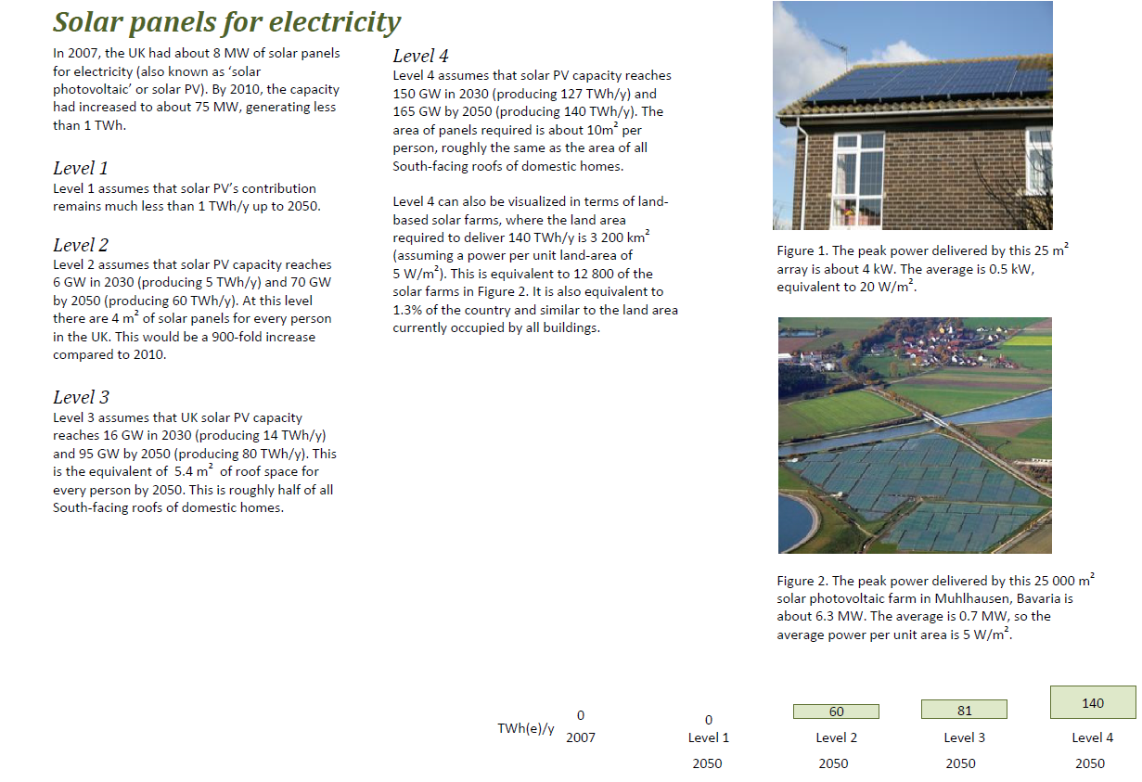
Level 4 example: Geographical constraint

Slide 7
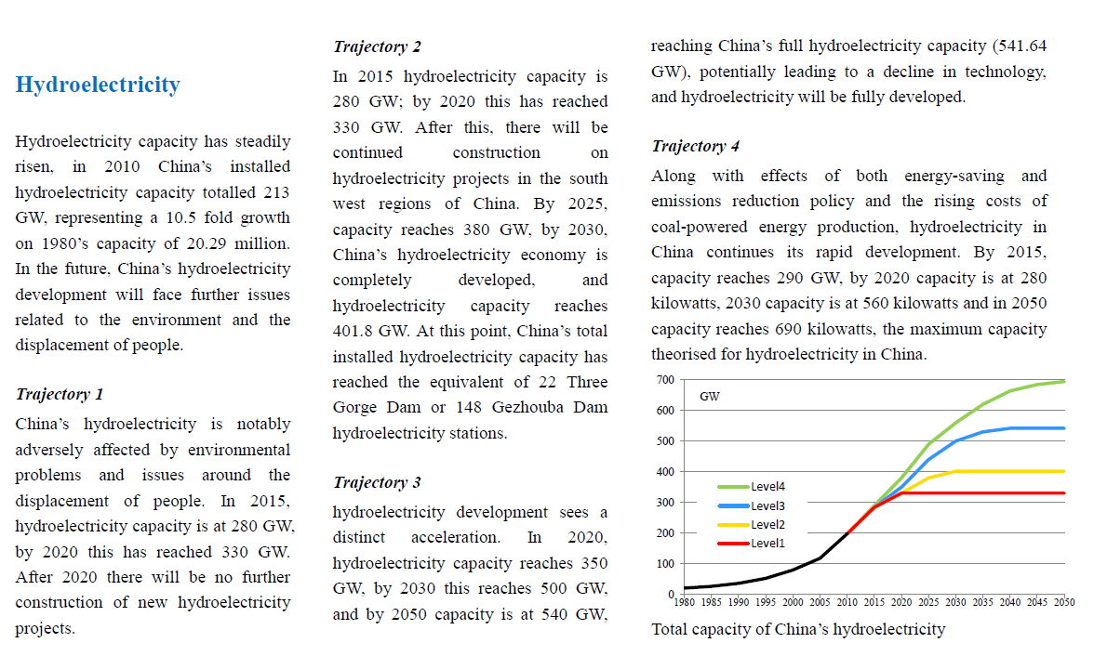
Level 4 example: Geographical constraint (China example)

Slide 8
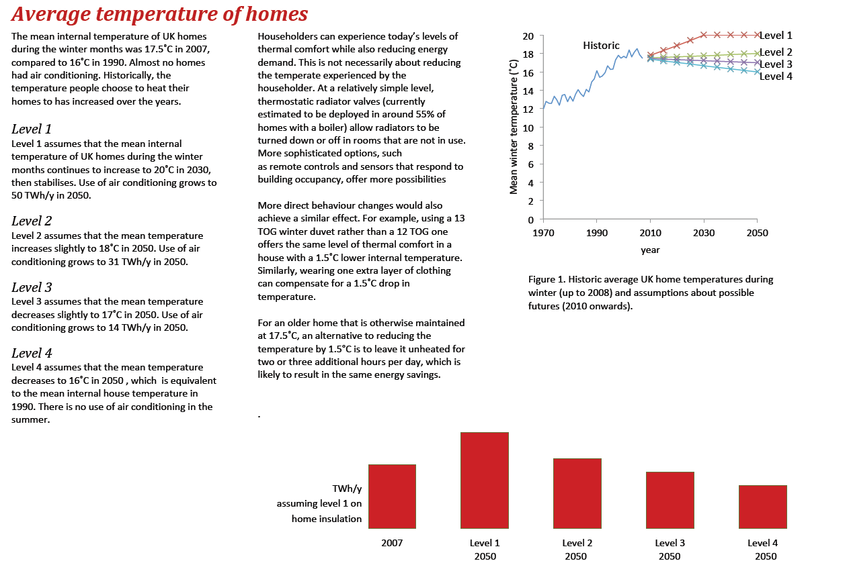
Level 4 example: Behavioural constraint

Slide 9
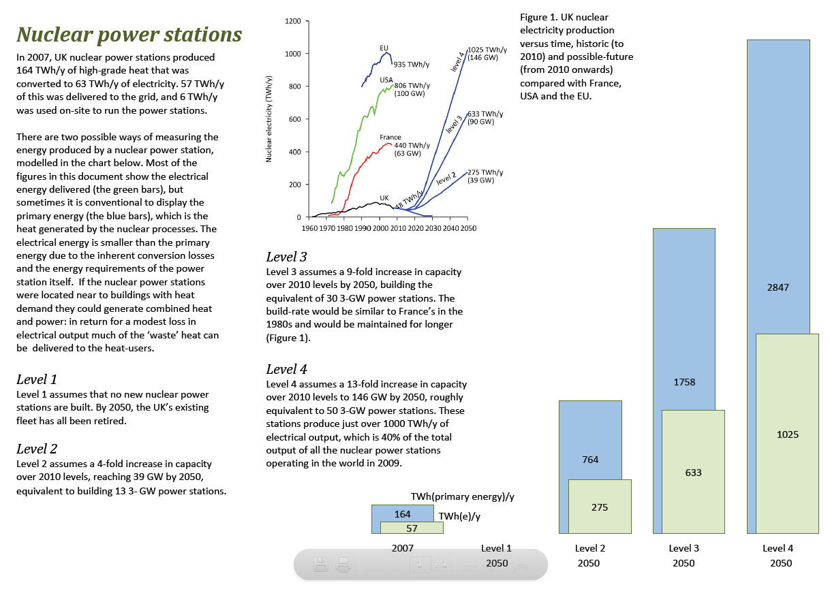
Level 4 example: Engineering constraint

Slide 10
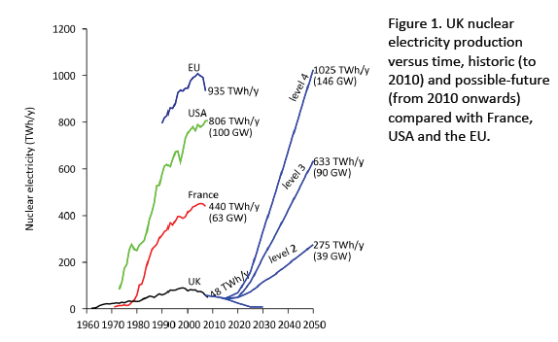
Here the UK used the example of another country to imagine what would be possible

Slide 11
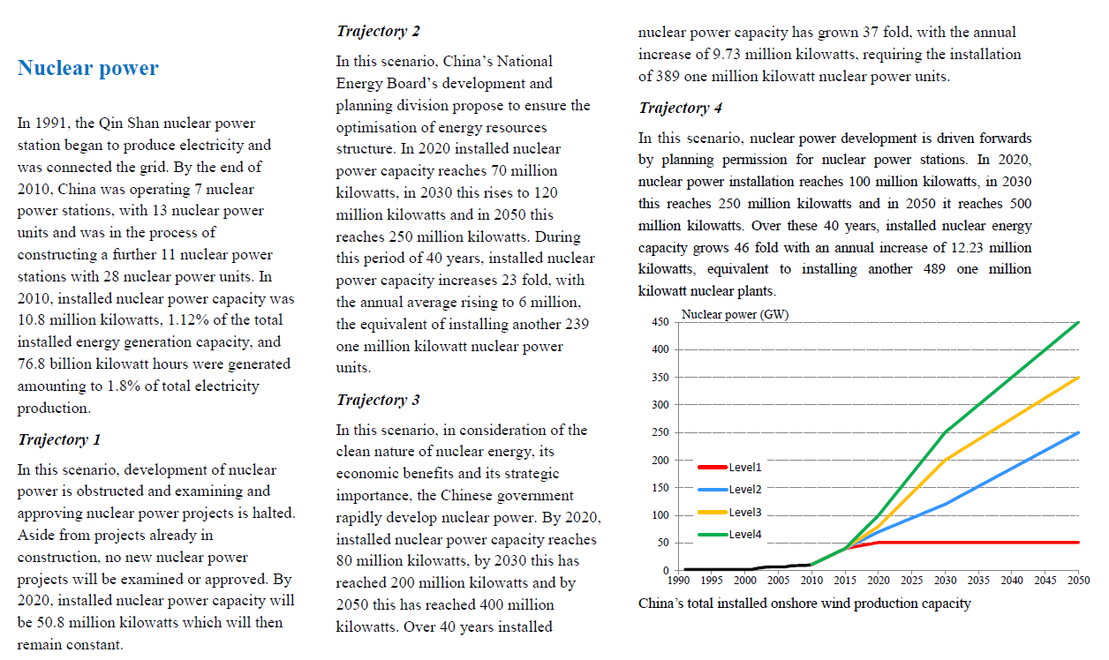
And just compare this with what China did
UK 2050 level 4

Slide 12
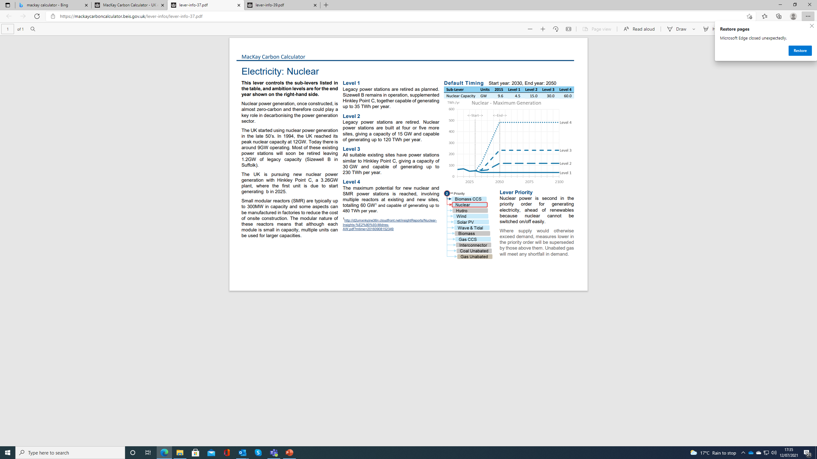

Slide 13
Levels 1-4: The principles for making this work
The principles of Levels 1, 2, 3 and 4
Level 4
Level 1
Levels 2 and 3
Trajectories between now and 2050
Explaining this to your stakeholders

Slide 14
Ways of describing how your Level 1 should be set
Tomorrow government announced that x technology would no longer be supported, and it was clear that the private sector would not do it alone.
No action is taken to change x behaviour, so current trends continue into the future.
Public opinion was so strongly against x technology that government prohibited its use within the country. All existing examples of the technology will be allowed to run until the end of their useful life.

Slide 15
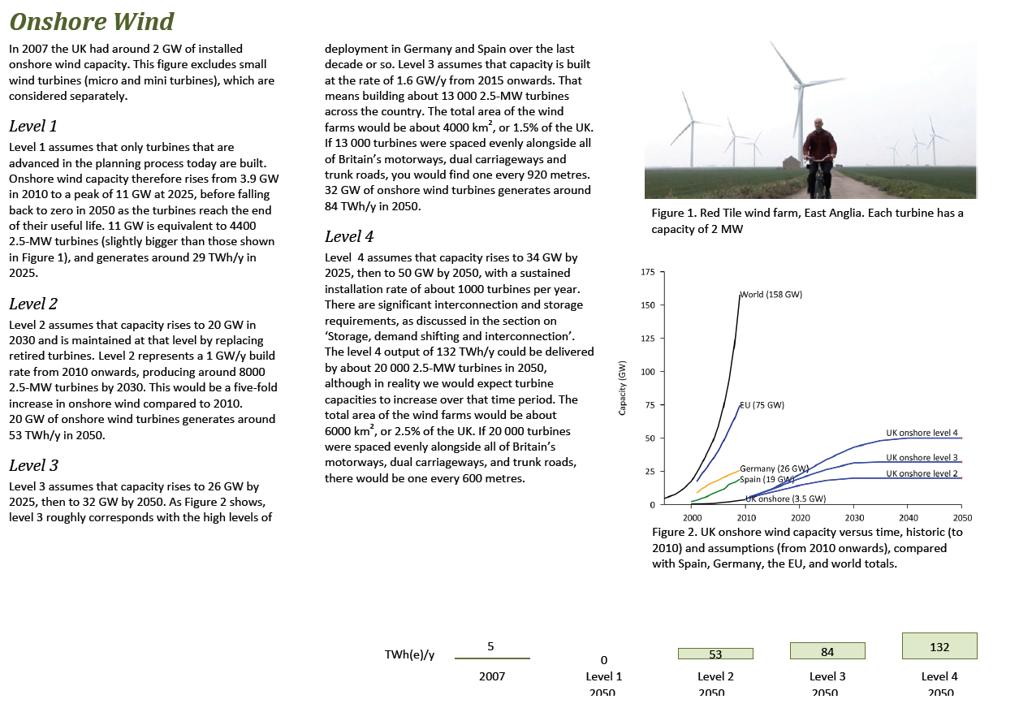
Level 1 example: Technology based

Slide 16
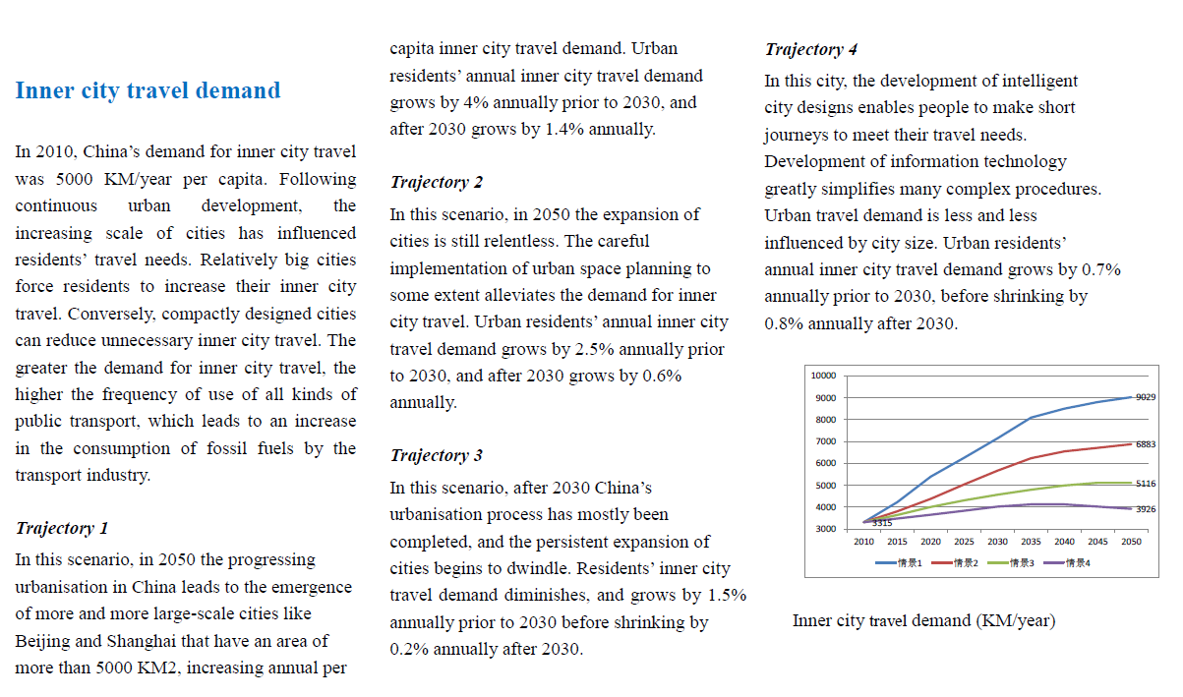
Level 1 example: Behaviour based (China)

Slide 17
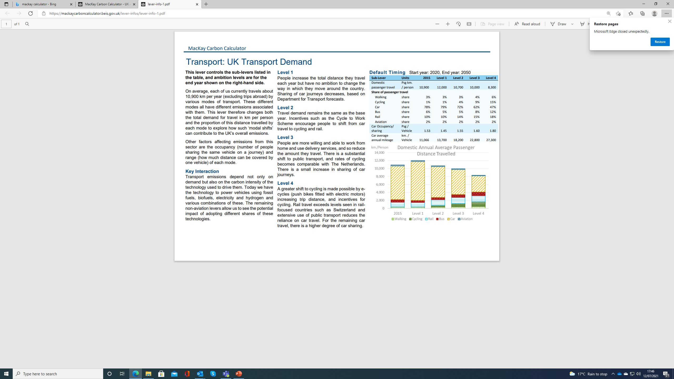

Slide 18
Levels 1-4: The principles for making this work
The principles of Levels 1, 2, 3 and 4
Level 4
Level 1
Levels 2 and 3
Trajectories between now and 2050
Explaining this to your stakeholders

Slide 19
Ways of describing how your Level 2 and 3 should be set
Levels 2 and 3 are designed to show two levels of realistic government intervention for a technology or behaviour.
Level 2 could be used to show your existing policies for a sector i.e. you are already taking action here and this is the impact it will have.
Level 3 is more than what is currently being done. Talk with your stakeholders about how this could look.
Level 3 should be ambitious, but still look within the realms of possibility.

Slide 20
Can you think of any examples of these in the Kenyan context?

Slide 21
Levels 1-4: The principles for making this work
The principles of Levels 1, 2, 3 and 4
Level 4
Level 1
Levels 2 and 3
Trajectories between now and 2050
Explaining this to your stakeholders

Slide 22
Your stakeholders can help you with the trajectory or build rate. Linear is a good first step
TWh

Slide 23
Levels 1-4: The principles for making this work
The principles of Levels 1, 2, 3 and 4
Level 4
Level 1
Levels 2 and 3
Trajectories between now and 2050
Explaining this to your stakeholders

Slide 24
Key messages to explain this to your stakeholders
The 2050 Calculator is designed to simulate different possible futures.
It needs to take into account a wide range of possible scenarios to do this. Levels 1, 2, 3 and 4 enable this.
We want your evidence to enable us to do this.
You don’t have to all agree. And range of views is good.

Slide 25
Deep dive into modelling the Electricity Generation

Slide 26
Links of Electricity Generation module to other modules
Electricity Supply
Electricity Demand
Electricity Generation
Transport (non-aviation)
Buildings Heat
Biomass CCS
Nuclear
Wind (onshore)
Wind (offshore)
Solar PV
Tidal Stream
Tidal Range
Wave
Gas CCS
Electricity Demand
Car All Types
LGV (van) All Types
HGV (rigid)
HGV (articulated)
Bus
Train Passenger
Train Freight
Transport Domestic Refuelling infrastructure
Heat pump air source
Heat pump ground source
Hybrid Heat Pump / Gas boiler
Electric Heater
Hydrogen Production
Electrolysis
Network Heat Source
Network Heat Pump water source
Network Heat Pump ground source
Network Biomass CHP
Network Gas CHP
Transmission
Distribution
Electricity Generation
(assumed fixed profile)
Transport (Aviation)
Hydro
Biomass
Coal Unabated
Aviation Domestic
Aviation International
Building Non Heat
Electricity Demand
Domestic Electric Stove
Non-Domestic Electric Stove
Domestic Lighting
Non-domestic Lighting
Domestic Appliances
Non-domestic appliances
Domestic Air conditioning
Non-domestic air conditioning
Farming & Forestry
Waste
CO2 Removals
Agricultural use
Energy from Waste with no CCS
Energy from Waste with CCS
Direct Air Capture
Enhanced Weathering
Industry
Industries
Fossil Fuel Extraction
Domestic Resource Extraction Fossil Fuel (Liquid)

Slide 27
Electricity generation technology in the UK Calculator
Negative Carbon | Low Carbon | High Carbon
Biomass with CCS | Nuclear | Coal unabated - Coal with no CCS
 | Hydro | Gas Unabated (Closed Cycle Gas Turbine (CCGT)) – Gas with no CCS
 | Wind (onshore)
 | Wind (offshore)
 | Solar PV
 | Tidal Stream
 | Tidal Range
 | Wave
 | Biomass
 | Gas with CCS
 | Interconnectors (imported electricity)

Slide 28
Electricity generation: Generation Capacity Deployment
Electricity demand
1.Biomass with CCS
Negative carbon
2.Nuclear
3.Hydro
4.Wind (onshore)
5.Wind (offshore)
6.Solar PV
7.Tidal Stream
Low carbon
8.Tidal Range
9.Wave
10.Biomass
11.Gas with CCS
12.Interconnectors (imported electricity)
13.Coal without CCS
High carbon
14. Gas without CCS
Electricity generation priority order

Slide 29
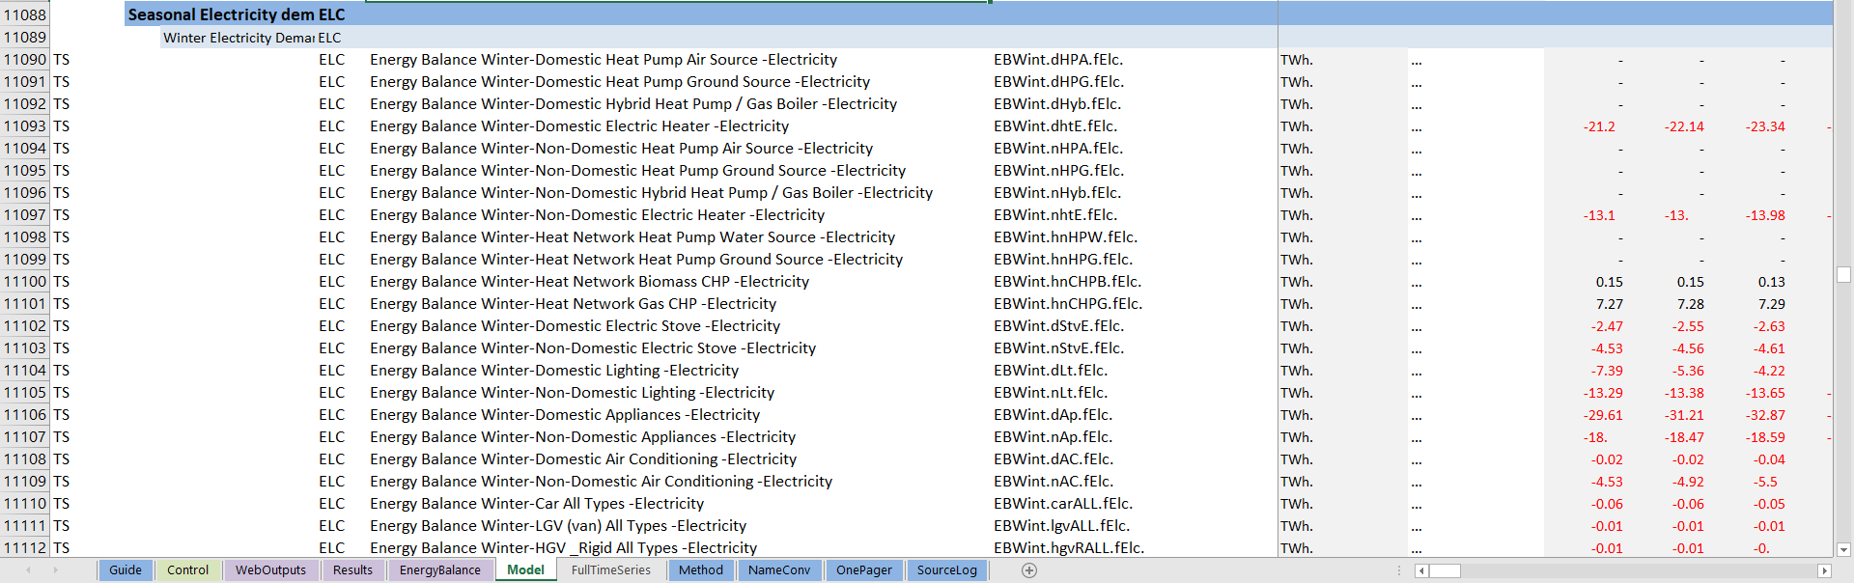
Example of calculation logic

Slide 30
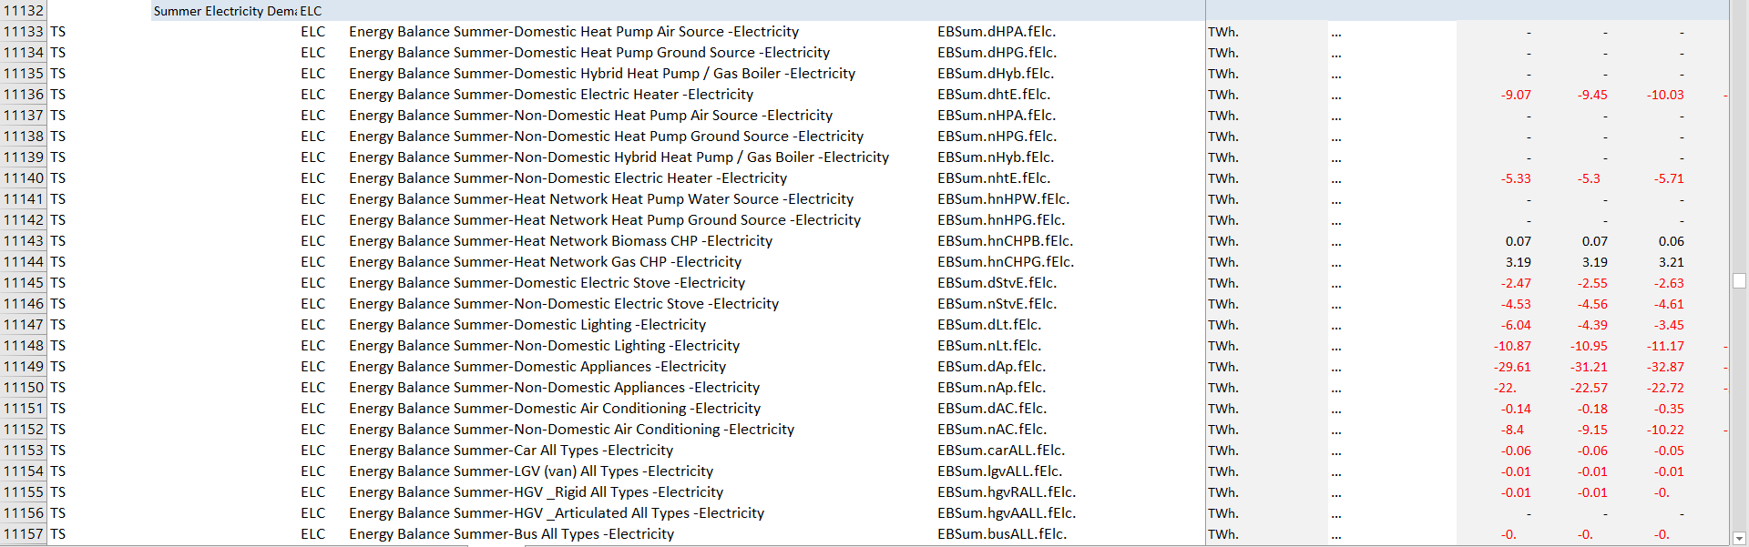
Example of calculation logic

Slide 31
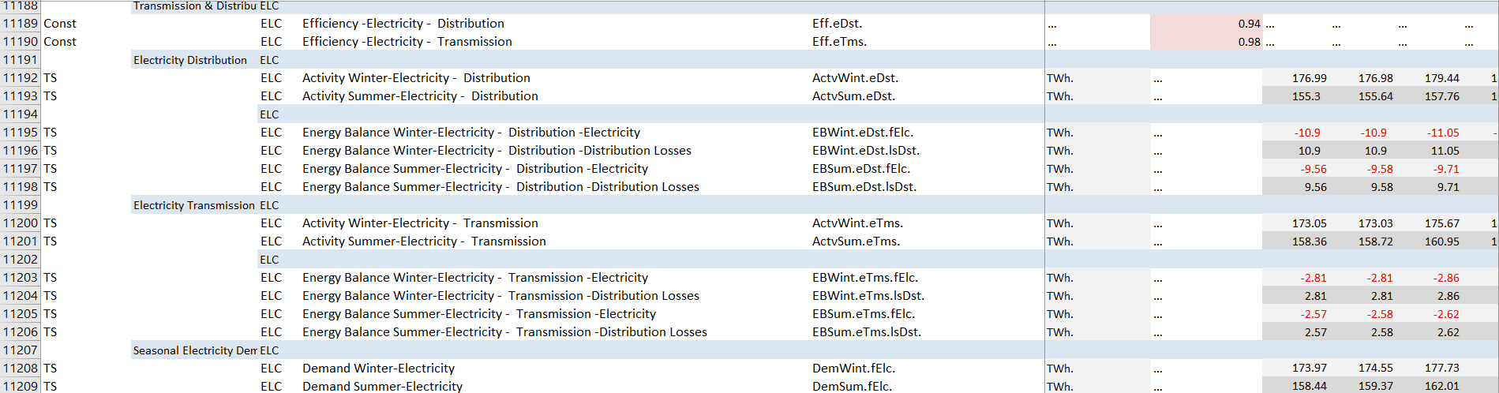
Example of calculation logic

Slide 32
Example of calculation logic
Winter electricity demand from various sectors
Buildings, Transport, Industry, Agriculture
Electricity loss in distribution network
Electricity input required for the distribution network
Electricity loss in transmission network
Electricity input required for the transmission network

Slide 33
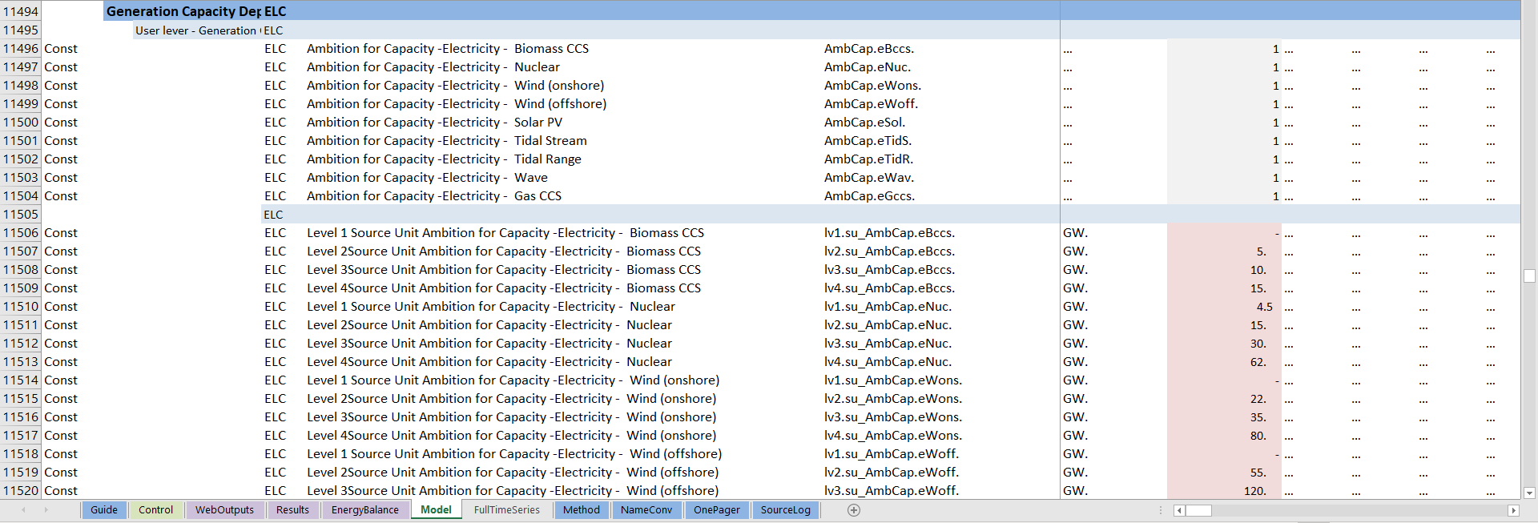
Example of calculation logic

Slide 34
Example of calculation logic
Biomass CCS
Nuclear
Wind (onshore)
Wind (offshore)
Solar PV
Tidal Stream
Tidal Range
Wave
Gas CCS
Level of ambition for capacity (GW)
Unit conversion to TWh
Time share for winter/summer
Load factor for winter/summer
Maximum electricity generation in winter/summer (GW)

Slide 35
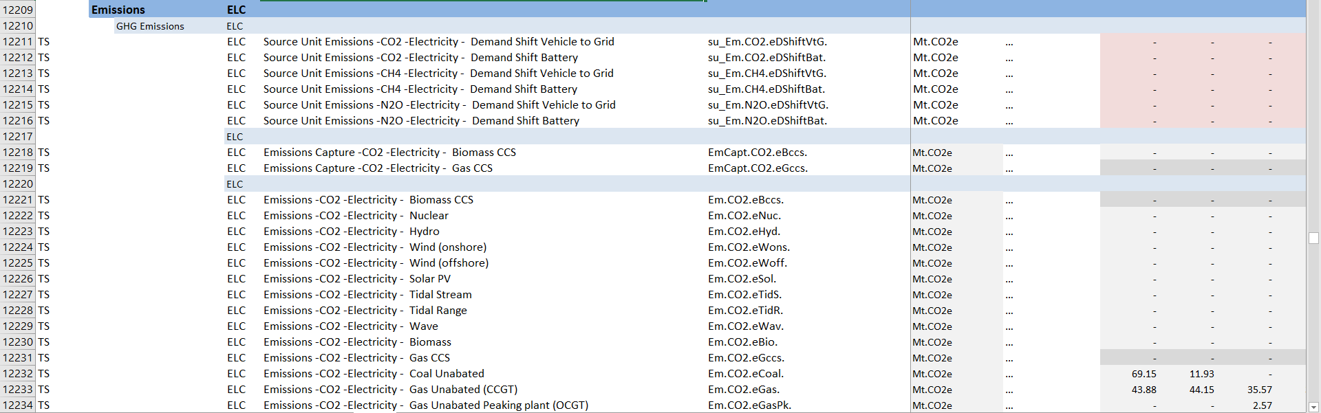
Emissions from the electricity generation

Slide 36
Emissions from the electricity generation
Nuclear
Hydro
Solar
Tidal
Wave
Biomass
Coal
Fuel used for electricity generation
Emission factor for the fuel used
Emission captured by CCS
Biomass CCS
Gas CCS
Emission from electricity generation with a technology

Slide 37
Levers for this sector
Levers | Base Year | Level 1 (GW) | Level 2 (GW) | Level 3 (GW) | Level 4 (GW)
Seasonal Storage |  | 0 TWh | 15 TWh | 30 TWh | 60 TWh
Short-term storage & demand shifting |  | 5 | 25 | 50 | 100
Interconnection |  | 6.5 | 9.0 | 14.5 | 20.0
Biomass with CCS |  | 0 | 5 | 10 | 15
Nuclear |  | 4.5 | 15 | 30 | 60
Onshore Wind |  | 0 | 22 | 35 | 80
Offshore Wind |  | 0 | 55 | 120 | 200
Solar |  | 0 | 70 | 165 | 300
Wave & Tidal |  | 0 | 9.5 | 34 | 68
Gas with CCS |  | 0 | 10 | 30 | 60

Slide 38
Electricity generation technology in the UK Calculator
Negative carbon | Low Carbon | High Carbon
Biomass with CCS | Nuclear | Coal unabated - Coal with no CCS
 | Hydro | Gas Unabated (Closed Cycle Gas Turbine (CCGT)) – Gas with no CCS
 | Wind (onshore)
 | Wind (offshore)
 | Solar PV
 | Tidal Stream
 | Tidal Range
 | Wave
 | Biomass
 | Gas with CCS
 | Interconnectors (imported electricity)

Slide 39
Discussion on Kenya: Generation Capacity Deployment
Electricity demand
1.Biomass with CCS
Negative carbon
2.Nuclear
3.Hydro
4.Wind (onshore)
5.Wind (offshore)
6.Solar PV
7.Tidal Stream
Low carbon
8.Tidal Range
9.Wave
10.Biomass
11.Gas with CCS
12.Interconnectors (imported electricity)
13.Coal without CCS
High carbon
14. Gas without CCS
Electricity generation priority order

Slide 40
Next steps
Team to familiarise with the spreadsheet model
Start considering and gathering data for each sector (Data tracker)
Continue identifying and mapping key sector stakeholders
Planning for co-design and expert sector workshops
Continue with deep-dive on sector logic trees (Land-use sector)​
Start to think about One pagers development

Slide 41






